Slide 1
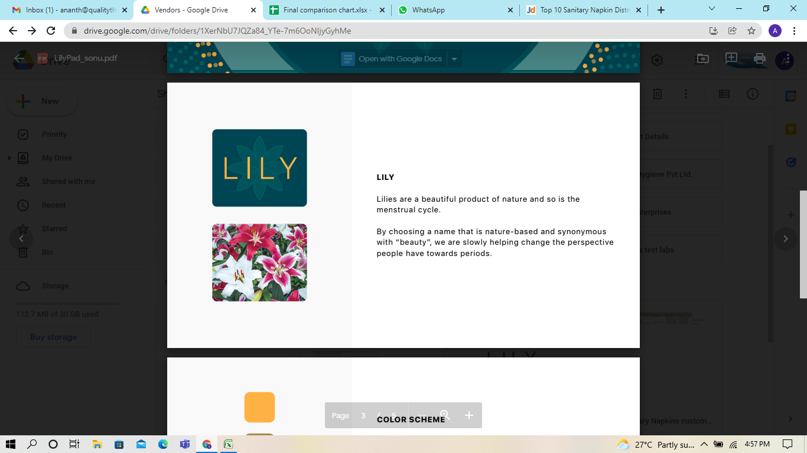
PadGeneral
745, 3rd Block, 10th Main Rd, 3rd Stage, Basaveshwar Nagar, Bengaluru, Karnataka 560079

Slide 2
Our Vision
Our Vision is to provide quality sanitary pads to serve the women's of rural and underprivileged communities.
Our Mission
Our mission is to create hygiene products that are good for the body, community and the environment in a sustainable and affordable way.

Slide 3
INTRODUCTION
PadGeneral is a partner ship company and just a startup with the great Vision in mind to serve the women's of rural and underprivileged communities by providing the knowledge for utilizing the Sanitary Pads and educate them on the hygienic and Health and Safety.
We are in the process of launching our product Sanitary Pad with in India and abroad by end of 2022, we will start our exports of our premier brand to US, UK and some parts of Europe.
The main focus is on Raw Materials vendors, checking the quality at the time of receipts, clearing the quality and then taking the Raw Materials for further process so there is ZERO rejection in the process.

Slide 4
Overview on utilization
Women’s health and hygiene has been one of the key concerns over the
years across the world. The awareness on menstrual hygiene and usage
of sanitary napkins is virtually absent in rural areas. Poor menstrual
hygiene can cause fungal infections, repeated infections to RTI, cervical
cancer and vulnerable to infertility.
The adolescent girls get information and education on menstruation
from her mother and grandmother, who themselves had practiced the
unhygienic behaviors for years and thus do not see any harm in the
practices of using old cloths during menstruation. By creating enough
awareness regarding menstrual hygiene's importance and use of
sanitary napkins, we try to prevent such chronic diseases from
happening in the rural areas.

Slide 5
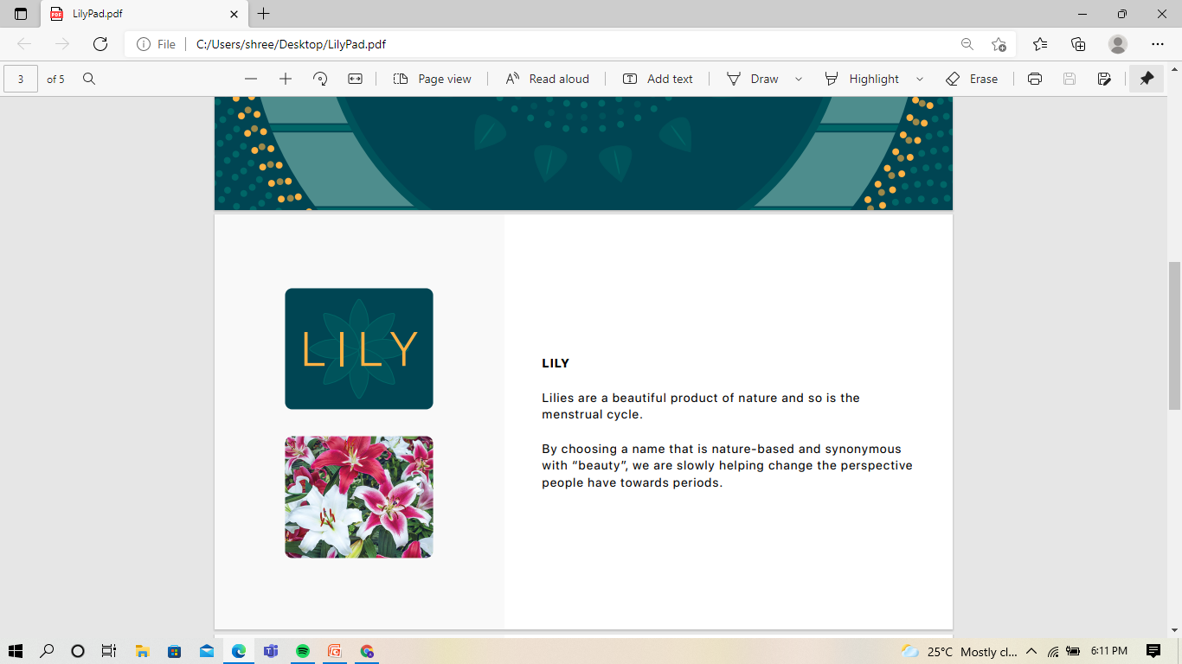
Our Brand
Lilies are a beautiful flowers of nature and so is the blooming of child hood to womanhood .
By choosing a name that is nature-based and synonymous
with “beauty”, we are slowly helping change the perspective
people have towards periods.

Slide 6
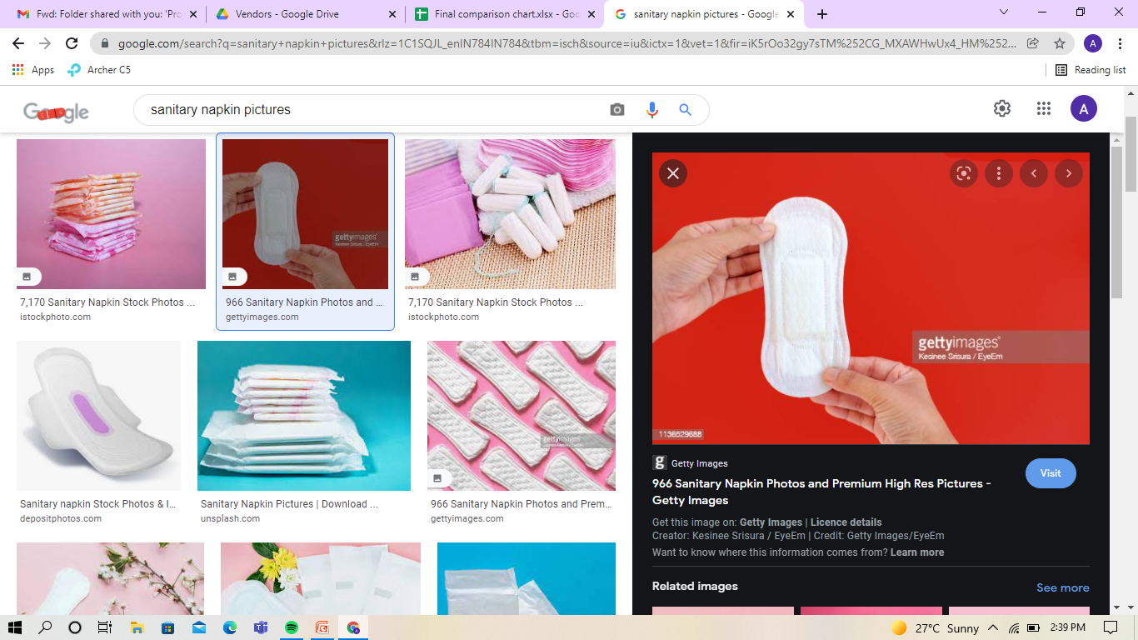
Our Product
Sanitary Napkin

Slide 7
Our Product
1st layer: Premium soft surface feels soft & comfortable
2nd layer: Ultra soft layer enhances softness & freshness
3rd layer: Super absorbent polymer locks in moisture, keeps surface dry
4th layer: Ultra soft layer
5th layer: Air- permeable layer eliminates moisture & heat fast, keeping
you fresh
6th layer: Specially designed back adhesive conforms with human
ergonomic

Slide 8
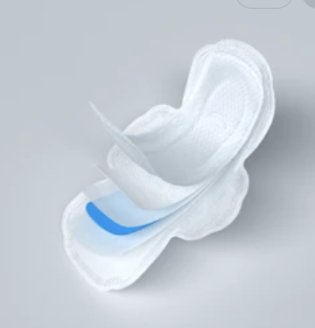
Our Quality
Special Features:-
Special designed end wings help hold the pad and help to protect your panties offer extra back leakage protection
Gel Layer is locked on all 4 sides by another layer ensuring no leakage on Side or below.
Super Adsorbent Gel converts liquid into Gel
Soft and smooth surface for comfortable and dry feel
QAS- Quick Absorption Strip
Strong Adhesive to keep Napkin firm in its place until it is removed for changing.

Slide 9
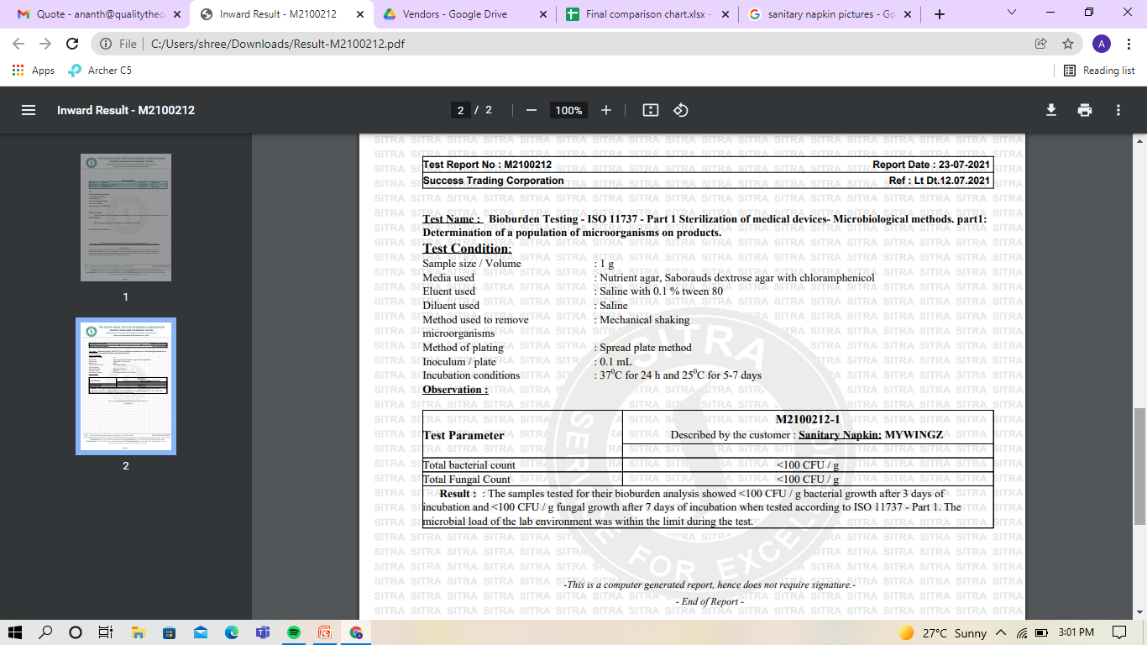
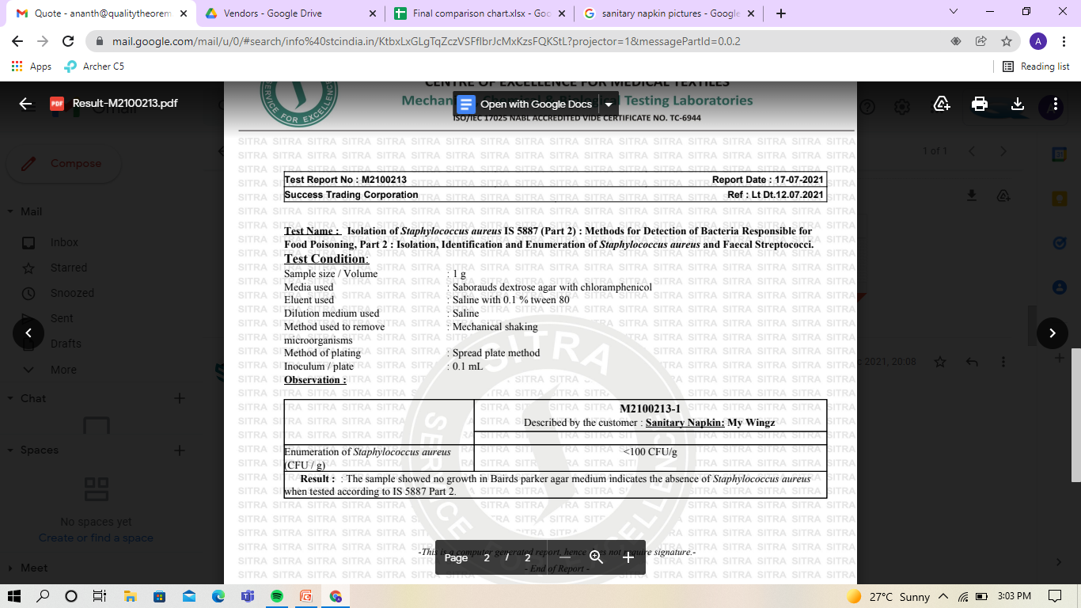
Our Quality
Test Reports

Slide 10
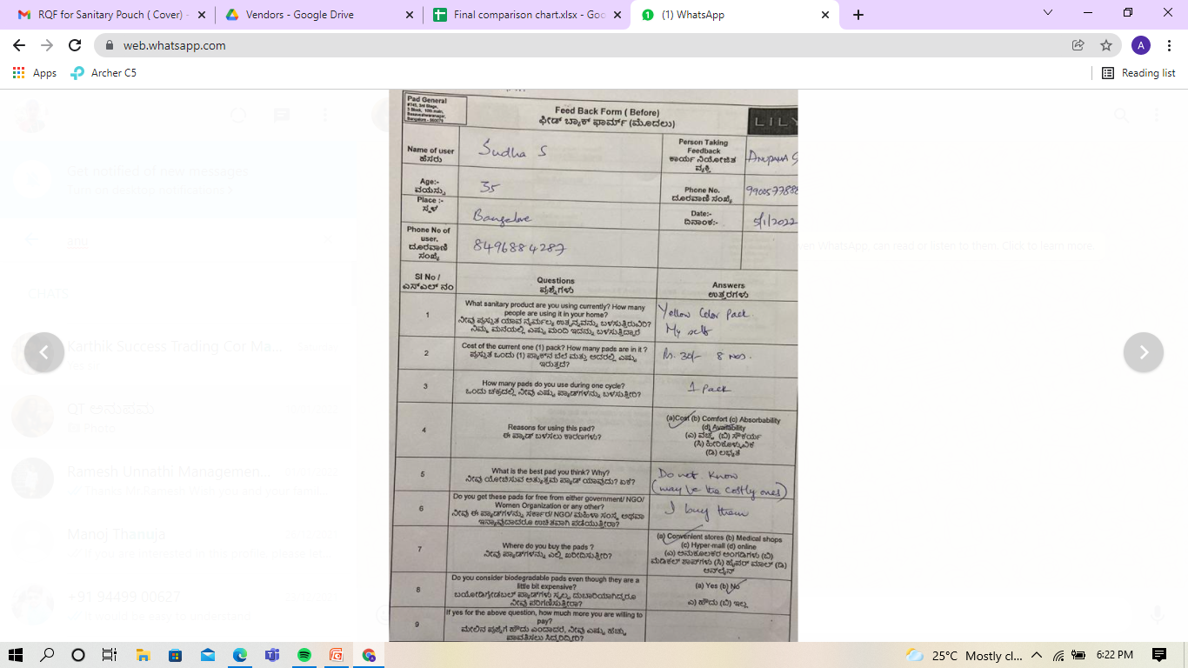
Our Quality
Feed Back Forms from Clinical Trial
Before the Product was launched to the market,
we ensured to taken Before and After feedback from some Customers on the product given to them for trial.
Like the Quality of the pad, which pad they were using, what is the price and how many pieces were they buying etc..
How comfort they are before and after using our product.
These all trial was to ensure we kept the Quality on top priority.

Slide 11
Our Quality
Data Collection and Analysis of Feed Back Form
Clinical Trial Feedback Analysis Details |  |  |  |  |  |  | Feed Back
Sl No | Supplier Name | Participant Name | Phone No. | Collected by | Collected Date | Location |  |  | Per Piece
1 | Maheswari | Sudha S | 8496884287 | Anupama | 01/05 | Bangalore | Yellow Color Pack My Self | Rs.30/- for 8 Pads | 3.75 | 1 Pack | COST Availability | Do not Know | I buy them | Convenient stores | No
2 | Maheswari | Geetha H.S | 9538947571 | Anupama | 01/05 | Bangalore | Pink Color Pack, My Self | Rs.35/- for 9 Pads | 3.88 | 1 Pack | Cost | Do not Know | I buy them | Convenient stores | No
3 | Maheswari | Parvathamma / Leelavathy | 9538485431 | Anupama | 01/05 | Bangalore |  | Rs.30/- for 8 Pads | 3.75 | 1 Pack | Cost | Do not Know | I buy them | Convenient stores
4 | Maheswari | Shilpa | 8884234664 | Anupama | 01/05 | Bangalore | Whisper, Myself | Rs.150 for 10 Pads | 15 | 1 Pack | Comfort, Absorbability | Do not Know | I buy them |  | Yes | if it is same price of Whisper
5 | Maheswari | Sarojamma | 7483253837 | Anupama | 01/05 | Bangalore |  | Rs.35/- for 9 Pads | 3.88 | 1 Pack | Cost | Do not Know | I buy them | Convenient stores | No
6 | Success | Sudha | 9148327043 | Anupama | 01/05 | Bangalore | Do not know the Brand, Its Myself | Rs.30/- for 8 Pads | 3.75 | 1 Pack | Availability | Do not Know | I buy them | Convenient stores | No
11

Slide 12
Organization Chart
CEO/ MD
Director
Operation
Head
SCM
Head
Director
Quality
Head
Finance
Head

Slide 13
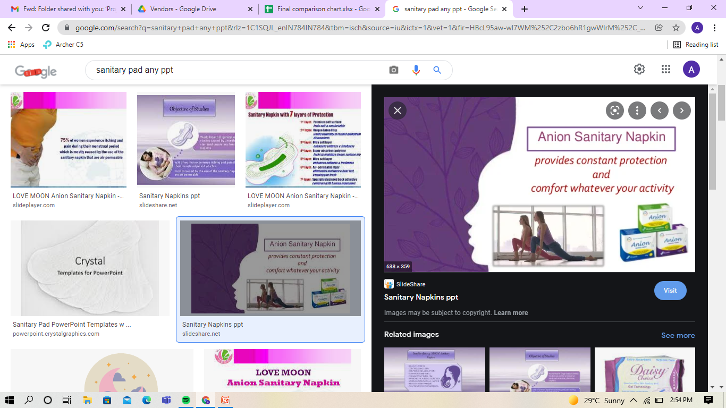
Acknowledgement
A pleasant way to take care of Our Women who always think of us and work for us in their life time.
We bring for them a Safe & Healthy, hygienic , rash proof, Organic ultra thin sanitary napkins.
A plan to serve the women of Rural and underprivileged community,

Slide 14
Contact Details
PadGeneral
745 , 3rd Block, 10th Main Rd, 3rd Stage, Basaveshwar Nagar, Bengaluru, Karnataka 560079
Contact No: -
Email :- info@padgeneral.com
Website :- www.PadGeneral.com

